Slide 1
LT Academy
Driver Features
Information accurate at time of release
Notes:
Welcome to LT Academy Driver Features

Slide 2
Agenda
Driver Features
Ergonomics
    Ingress / Egress
    Knee Room
Visibility
Interior Features
  NVH
  Instrument panel
  Shifter Stalk
  Instrument Cluster
  Center Stack
Notes:
We will look at Driver Features for the LT Series truck. Next we cover Ergonomics including ingress and egress as well as interior knee room. Then we will take a look at the visibility improvements and finally we will cover the interior features, including Noise Vibration and Harshness items, Instrument panel, shifter stalk, instrument cluster and the center stack.

Slide 3
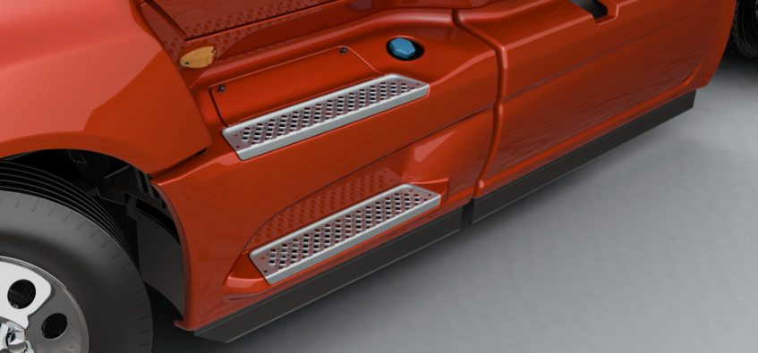
Ingress / Egress
Step positioning
  Requirements are driven towards tailoring the best option for the 5th percentile female (5’) to 95th percentile male (6’ 3”)
  Optimal lower step height for most drivers is 17”
  LT lower step height to 17”
  Narrow body cab creates a staircase effect, aiding ingress / egress to reduce the chance of falls
Notes:
We looked at the step positions and moved the step to 17”. This is tailored to the 95th percentile male and 5th percent female. The steps are staircase style so it makes it aids in getting in and out of the cab of the LT Series truck.

Slide 4
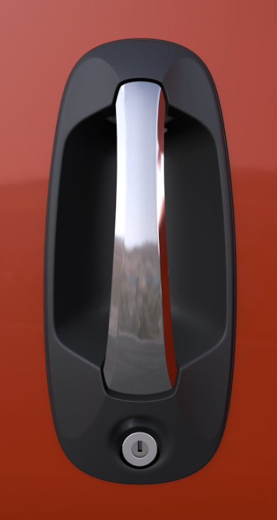
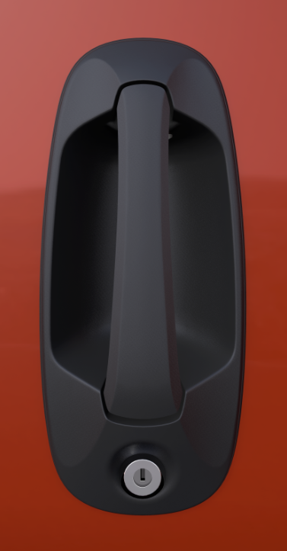
Ingress / Egress
Door handle
  Improved sturdy feel
  Ergonomically redesigned for easier use with heavy winter gloves
Door lock tumbler
  Tumbler mechanism is now only removed from inside the vehicle, to increase vehicle security
Door hinges
  Opening angles increased to improve ingress / entry
    Full open resting position: 58°
    Last detent: 62°
Notes:
Handle: The LT has a sturdy strong feel on the door handles. The handle itself is wider and the cup area was redesigned to allow easier access even with heavy winter gloves. The door lock cylinder on the ProStar was rather easy to bypass from outside the truck. That is not the case with the LT Series. To access the door lock cylinder on the LT the door panel will have to be removed. The door hinges were also improved. The full opening and the last detent now allow the door to open a little further to make it easier for ingress and egress.

Slide 5
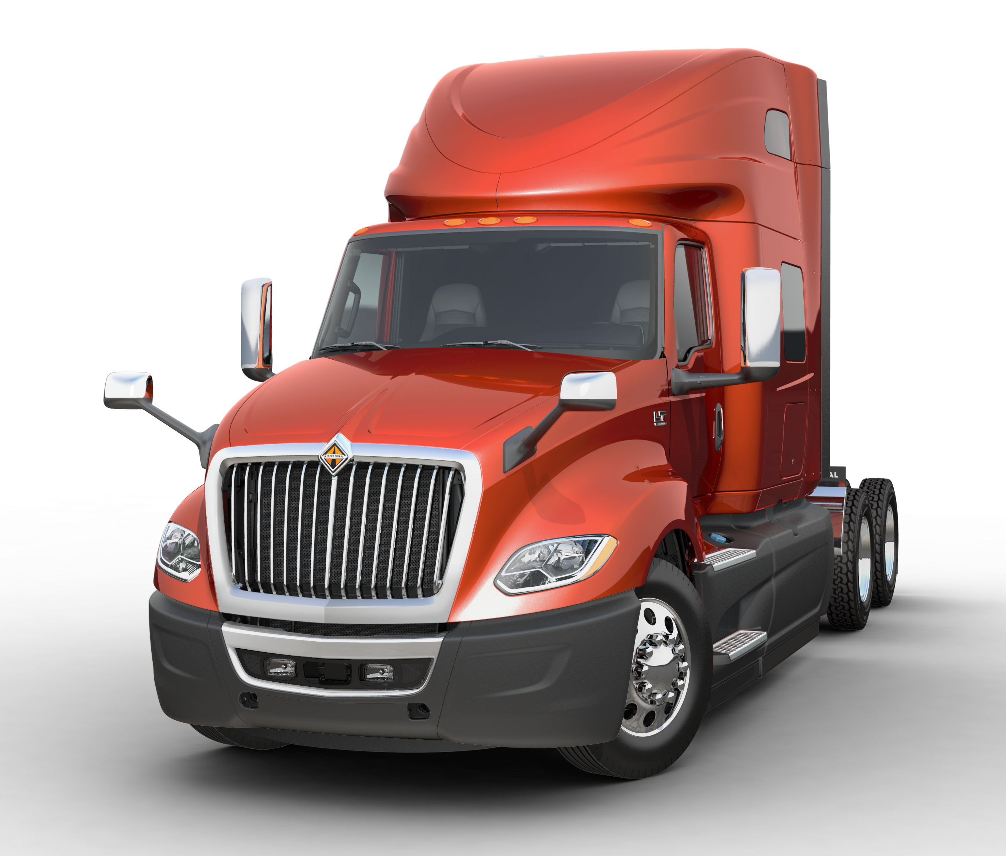
Visibility
Door mirrors
  Placement optimized to reduce neck rotation angles and improve safety
Hood mirrors
  Mirror vibration greatly reduced, providing a stable image to the driver
 | Driver / Passenger | Percent Improvement Driver / Passenger
ProStar | 59° / 76° | -
LT C-Loop | 50° / 72.5° | 15% / 5%
LT Pedestal | 52° / 72.5° | 12% / 5%
Notes:
We also looked at the mirrors on the LT Series truck. The door mirrors have been move forward so the driver does not have to rotate their neck as much which should help with fatigue. The LT has the pedestal door mirrors as standard but the C-loop are still available. People have commented on the stability of the mirrors and the open visibility feel with the pedestal mirrors.
The optional hood mirrors have also improved over the previous models. They are reinforced on the mounting and image vibration has been greatly reduced. It should be mentioned that there are dimples on the reinforcement under the hood where to drill to mount the hood mirrors. Therefore if your customer wants to add the hood mirrors later it can be done without to much difficulty.

Slide 6
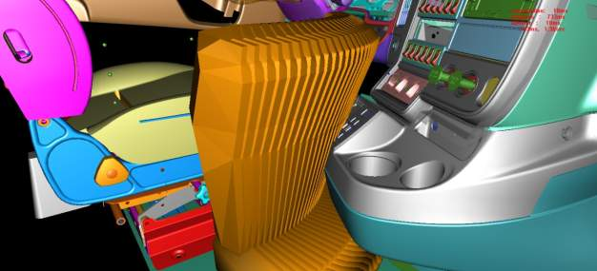
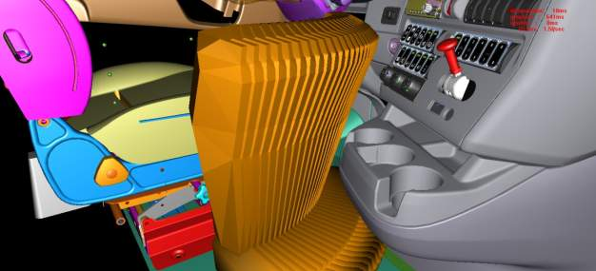
Knee Room
Cab to sleeper transition knee room
  Lower console moved forward
  Stalk mounted shifter replaced push button shifter
    Knee room increased 1.57” (40 mm) to ease transition from the cab to the sleeper
Notes:
With the redesign of the center lower console, moving the gear selector to the shifter to the stalk it provides over 1 ½ more legroom when transitioning from the drivers seat to the sleeper area.

Slide 7
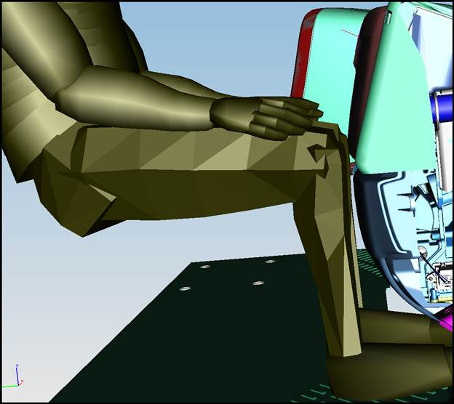
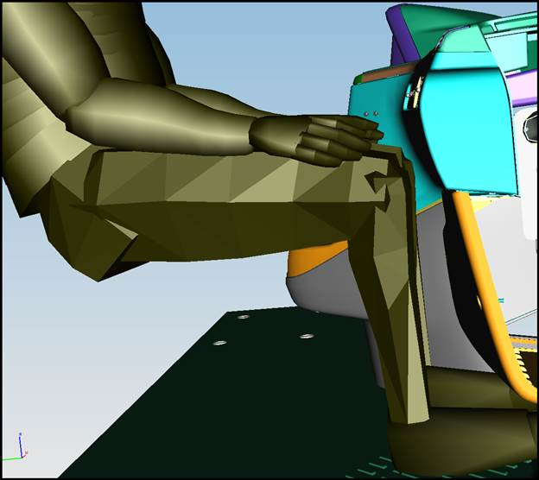
Knee Room
Passenger knee and leg room
  Lower instrument panel moved forward
    Knee room and leg room increased 1.96” (50 mm)
Notes:
The HVAC system was totally redesigned, and due to that, the instrument panel in front of the passenger does not protrude into the passenger compartment as far as it did in the ProStar. As a result the passenger now has almost 2” more knee and leg room.

Slide 8
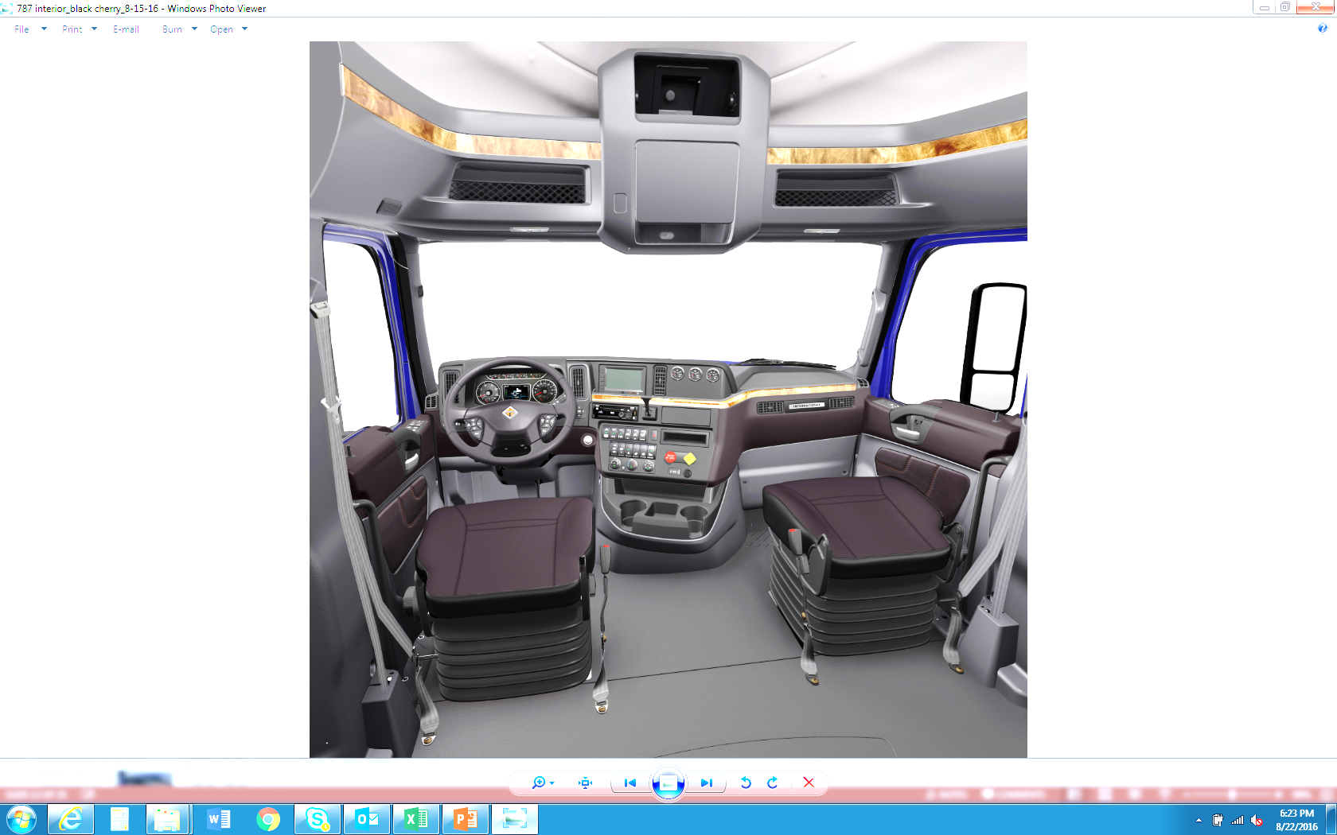
Feels Bigger
Notes:
When we showed the new LT Series truck to customers the comment we heard multiple times was “you made the cab bigger” because of the changes we made to the dashboard, the center stack, the door panels and the door windows it feels bigger.

Slide 9
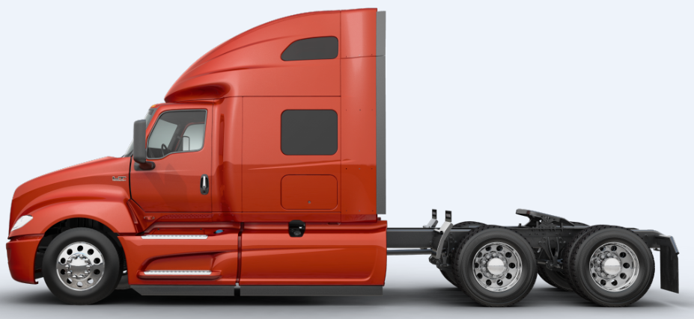
Visibility
Door windows
  Large single door windows improve visibility, by approximately 20” in the forward section of the window, a critical area for safety
Notes:
Speaking of changes to the door window you probably notice the vent window is gone and the door glass area is larger. This contributed improved visibility of 20” in the forward section of the window. So you can see closer to the front of the LT Series truck so it is safer, especially if someone is walking in front of the truck.

Slide 10
Interior Noise
LT is a quieter cabin
  Improved Wind Noise
  Improved Door Sealing
  Insulated flooring
The new LT design resulted in a 4 sones wind noise reduction over ProStar
Critical components affecting wind noise were optimized
  Side glass (vent window eliminated)
  Door seal
  Pedestal mirrors
  Hood shape
  Hood to door geometry
Wind noise simulation was used extensively throughout the development process to guide the design and achieve wind noise reduction objectives
Notes:
The LT Series truck is noticeably quieter inside the cabin and people have noticed and commented on it. We have reduced wind noise, improved the door seals and floor insulation. Some of the items we optimized were, removal of the vent window eliminated an additional sealing surface which could contribute to wind noise. We also improved the sealing area on the doors and the doors are 2 times stiffer than the ProStar model. The door seal improvement not only helped with wind noise but it should help with the customers that had a concern with their foot or leg getting cold. The Pedestal mirrors and the hood shape as well as the transition of the hood to the door has not only helped with aerodynamics but wind noise too. The LT Series Truck has a 4 sones improvement in wind noise over the quietest ProStars.
Sones are a linear measurement of how sound is sensed. A sone is a measurement of sound in terms of the comfortable hearing level for the average listener. The lower the sone value, the more comfortable the listening environment will be. Normal human conversation occurs at 1 to 4 sones.

Slide 11
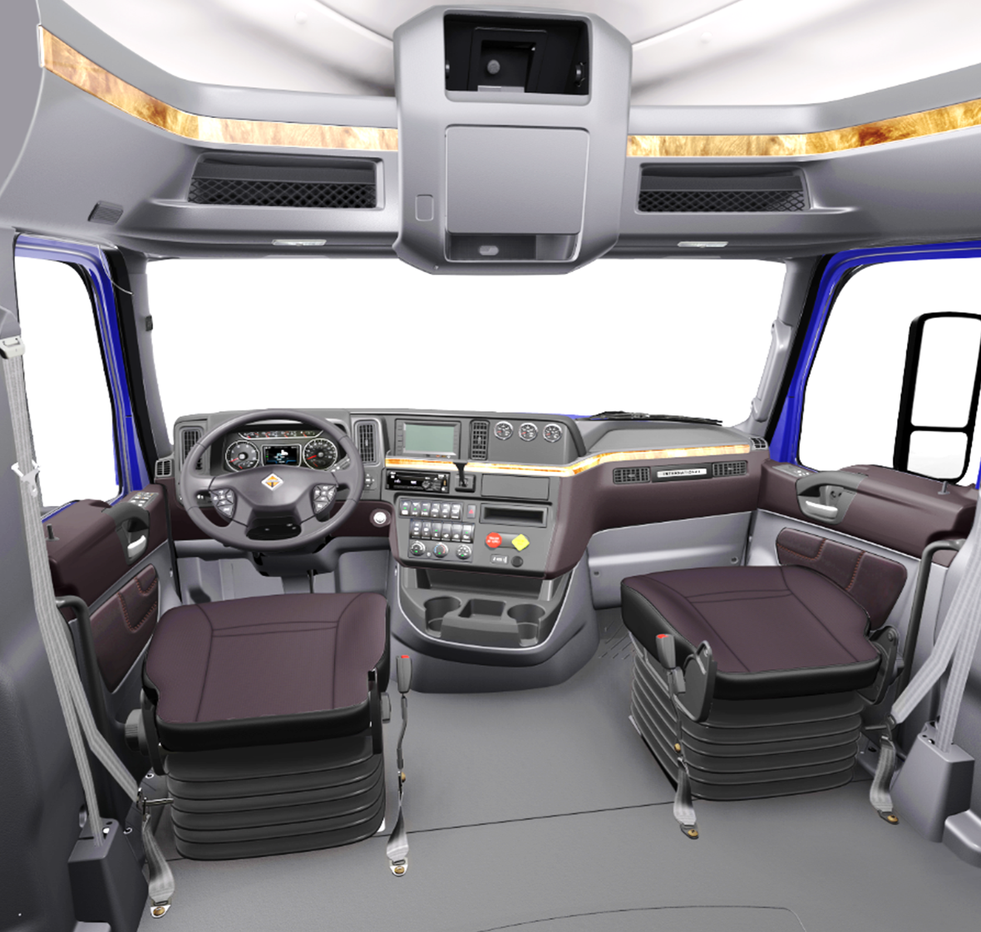
Interior Changes / Ergonomics
Air horn lanyard
  Roof mounted as recommended in driver clinics
  Steering wheel mounted buttons difficult to locate during evasive maneuvers
Doors
  Ergonomic design enhances comfort and visibility
Interior panels
  New materials reduce bumps, squeaks, and rattles (BSR)
Notes:
On the interior we have made improvements too. The drivers asked for the air horn lanyard to come back. When they explained that when they are in an evasive maneuver it is hard to find a button on the steering wheel that is moving. So the lanyard is back on the roof at the top front of the drivers door opening. The doors were changed to enhance both comfort and visibility. The interior panels are now made with a material called TPO. Thi material helps reduces squeak when panels come together overall helping to reduce bump squeak and rattle concerns.

Slide 12
Interior Changes / Ergonomics
Engine fan
  Less fan blades reduce interior noise (A26 and X15)
HVAC
  More powerful system delivers more heat in cold weather
  Five vents (one additional over ProStar) improve air flow throughout the vehicle
  Vents can now be fully closed, preventing cold hands when AC on
Notes:
We are mentioning the engine cooling fan here on interior because of the impact to interior noise. We have changed the cooling package on the LT and what that means is we do not need as many fan blades to cool the engine. Currently the ProStar has 11 blades for N13 and the ISX15. With the LT we will have 9 fan blades with the Cummins X15 and only 6 fan blades with the A26 engine (2017 International 12.4 liter). Not only does this reduce noise but it also takes less horsepower to turn few blades.
I mentioned earlier the we completely redesigned the HVAC system on the LT. We now have the Best In Class HVAC for Class 8 Trucks. We now have five dash outlets which is one more than we had with the ProStar. This improves the airflow throughout the cab and the vents can now be fully closed if desired. This should help with the concern that we have heard in the past with cold air blowing on the drivers hands with the A/C on. It also should help with air blowing on the drivers eyes drying them out, increasing fatigue.

Slide 13

Interior Changes / Ergonomics
Hazard switch
  Moved to the center of the wing panel
Pagination switch
  Located to the right of the steering column
  Premium cluster only
Storage
  2 cup holders
  2 bottle holders
  Added compartments including cavity in place of optional driver information display
  Deeper door map pocket
  Center console storage with convenient power
Notes:
Additional interior changes include the moving of the hazard switch to the wing panel rather than on the steering column. Trucks use the hazard switch frequently when making deliveries or stopping so it is easier to get to on the dash and not reaching through the steering wheel. If the LT is equipped with the premium cluster it will have a pagination switch which is located just to the right of the steering column. Storage is improved too. We have both cup and bottle holders and a deeper door map pocket as the drivers requested. We also added compartments to the dash. If you do not order the driver information center it will be a storage bin rather than a blank area.

Slide 14
Interior Changes / Ergonomics
Trailer brake
  Located on wing panel
USB and Aux port
  Relocated near storage
  1 each std., 1 each opt., 1 added USB in some radios
Window and door locks
  Modern, automotive style
Wing panel
  Contoured
  Frequently used controls nearer to the driver
Notes:
The controls were designed to have the items that are used most frequently closer to the driver. The trailer brake was moved up to the center of the contoured wing panel were it is easy to use. The LT has one Auxiliary Power Outlet and one USB charger port standard, and there are storage cubby's nearby to hold the device being charged so we do not have cords draped all over. Door locks and window switches changed to a more modern automotive style too.

Slide 15
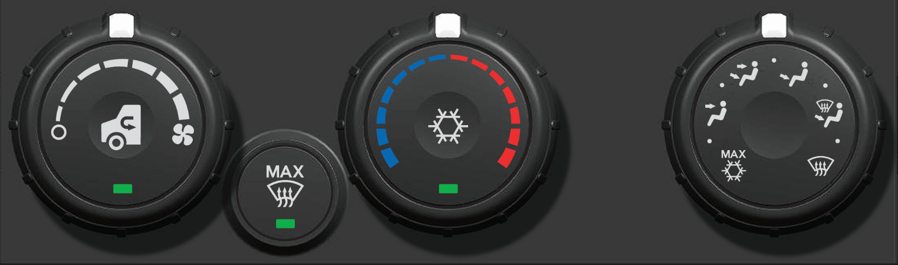
HVAC Controls
Features
  A/C can be operated in all modes
  Recirculation mode works in all modes except defrost
  With blower off, can operate in recirculation mode. Mode and temperature doors allow control at highway speeds with or without ram air with blower off
Recirculation button
Dot between panel and maximum A/C
Panel, recirculation, A/C on
Maximum defrost button
Goes to defrost, full hot, fresh air, high blower
Can be over-ridden by adjusting blower or temperature
AC Button
Maximum A/C button
Goes to panel, full cold, recirculation, high blower
Can be over-ridden by adjusting blower, temperature, or recirculation
Notes:
The HVAC controls are all new for the LT Series Truck. We wanted to have the best in class HVAC and the new controls helped us reach that goal. As you can see we now have a Max Defrost button as well as the Max A/C button but both can be overridden if desired. In addition the A/C can be operated in all modes now. We will talk more about the performance in the LT Academy Uptime WBT.

Slide 16
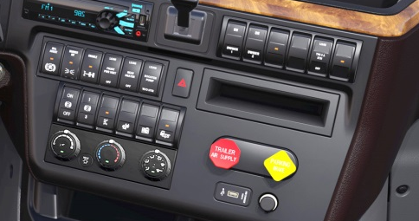

MUX and Steering Wheel Switches
MUX switches
  Laser etched and backlit for readability over the vehicle life
    Residual value benefit
  Now include ISO symbols
Steering wheel buttons
  Laser etched and backlit for readability over the vehicle life
    Residual value benefit
  Features added to steering wheel
    Blue tooth
    Cruise control cancel
    Radio controls
Notes:
One item we heard from clinics with decision makers was the switches and steering wheel controls wear out negatively impacting residual value. So all the MUX switches and steering wheel controls are now laser etched so you they should not wear through and they are backlit too. We also added the ISO symbols for identification and blue tooth, cruise controls cancel and radio controls are now available with the steering wheel controls.

Slide 17
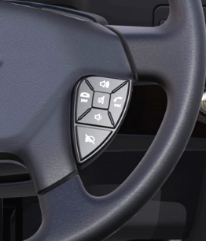
Hands-free Calling
Bluetooth
  Steering wheel mounted controls for call pick-up and hang-ups
  Microphone relocated to A pillar, allowing the driver to speak in a normal voice level
Notes:
The Bluetooth microphone in relocated near to the drivers head area on the A pillar as you can see in the image on the right. If you remember we reduced the interior noise by 4 sones so the driver should be able to speak with a normal voice level. The image on the left is of the new Bluetooth steering wheel controls so the driver does not have to take their hands off the steering wheel to pick up or hang up which is obviously safer.

Slide 18
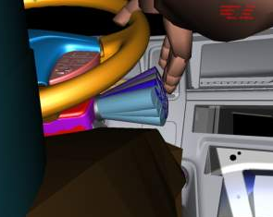
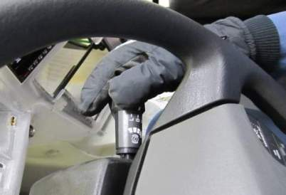
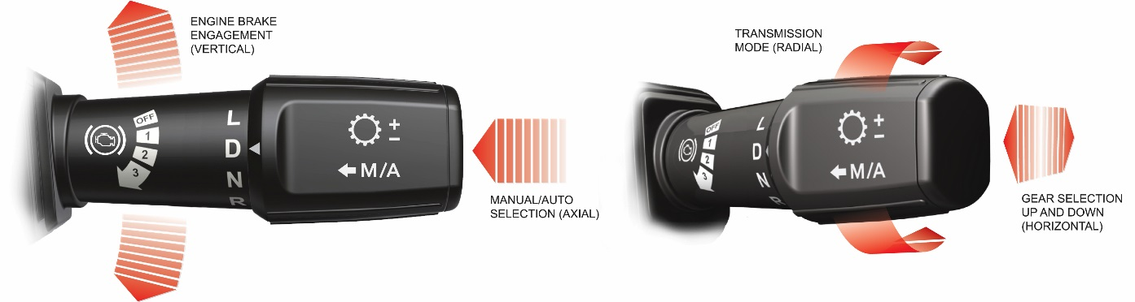
LT Interior Changes for Comfort and Ergonomics
Stalk shifter
  Integrates L-D-N-R, engine brake and manual shifting into a single control
  Ergonomically located for hand on steering wheel
  Easily used with heavy winter glove
  International is first to use a stalk shifter with Allison transmissions
Notes:
This is our new Stalk Shifter. It integrates the gear selector, engine brake and manual shifting into one controller. It is located on the right side of the steering column and is robust enough to be easily used with winter gloves. This will be used with Automated Manual Transmissions as well as the automatic transmissions. By moving the stalk up or down you can control the engine brake. If you rotate the end forward it goes into a forward gear and if you rotate it backward from neutral it goes into reverse. You can also manually select the gear you want by pushing away or pulling toward you the end of the stalk. It is also important to note that we here are International are the first to offer the stalk shifter with Allison transmissions.

Slide 19
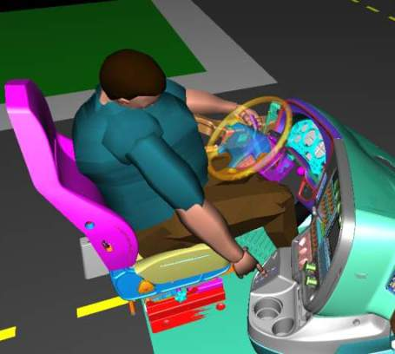
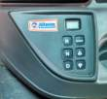
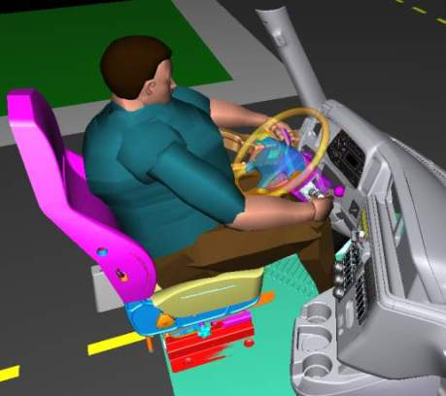
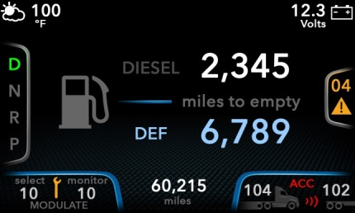
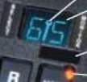
Stalk Shifter Enables Eyes on the Road
Eyes leave the road
Eyes stay on the road
Notes:
We will talk more about the cluster in a minute, but with the stalk shifter the driver does not have to take their eyes off the road to look for the shifter nor to see what gear they are in. That information is on the cluster and stalk shifter is easily located and accessible with hands on or near the steering wheel

Slide 20
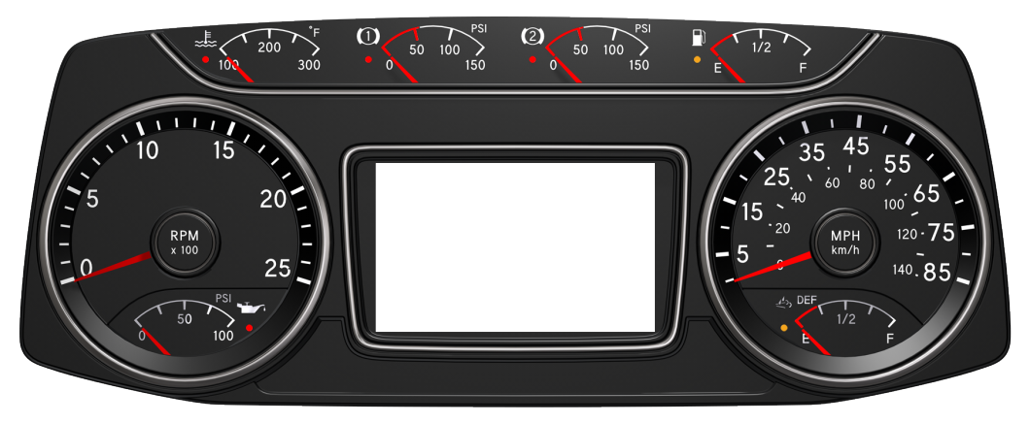
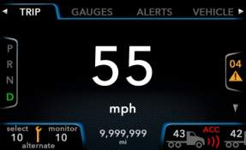
Premium Cluster
All necessary driver communications in one location
  Alerts, advanced braking, cruise control, transmission, TPMS
Notes:
This is our premium cluster which is standard equipment on the LT Series truck. As you can see we have the 8 most used gauges available at a glance. I should also mention if your customer elects to go with the base cluster the same 8 gauges are displayed. The difference is the center display.

Slide 21
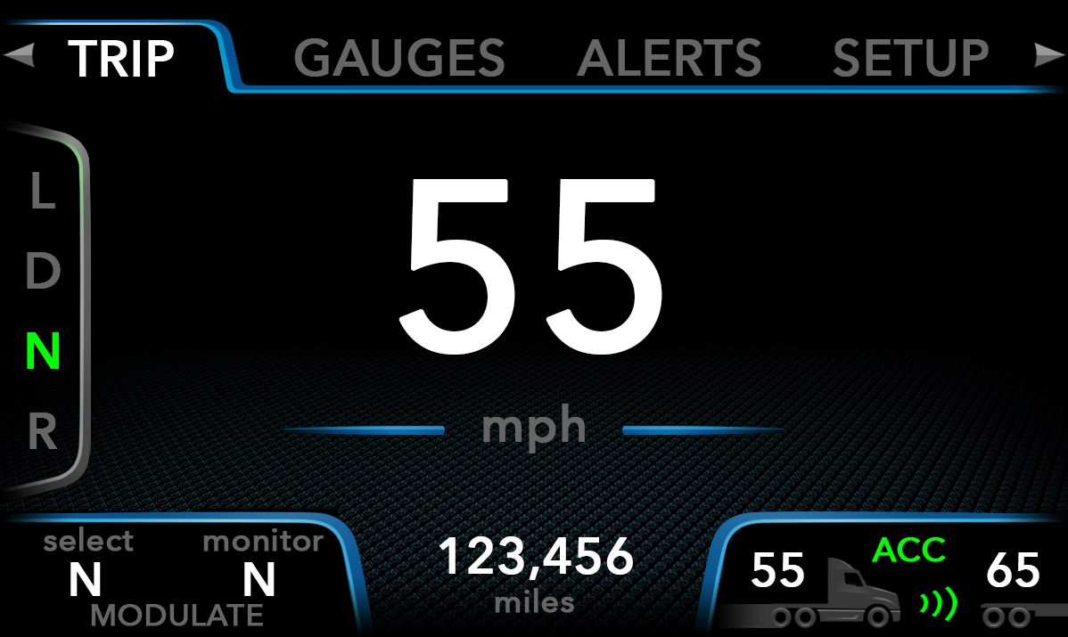
Premium Cluster
Main menu
  Activated by left or right switches on pagination control module
    Favorite Screen 1 MPH/KPH
    Dedicated area for gear selection
    Active fault codes displayed here
      Yellow faults can be turned off
    Dedicated area for Eaton / Allison transmission
    Dedicated area for cruise control and adaptive cruise control
    Dedicated area for total odometer
Notes:
Here is the center display of the premium cluster. We have dedicated areas for information being displayed in this area. Across the top you see the main menu that will be selected and adjusted by the pagination switch. There are dedicated areas for gear selection odometer and cruise control. The area on the right is dedicated to display any active faults. It should be noted if a fleet does not want the driver to be alerted to yellow faults they can be turned off. The center area is customizable and has some favorite screens that can easily be chosen and moved through.

Slide 22
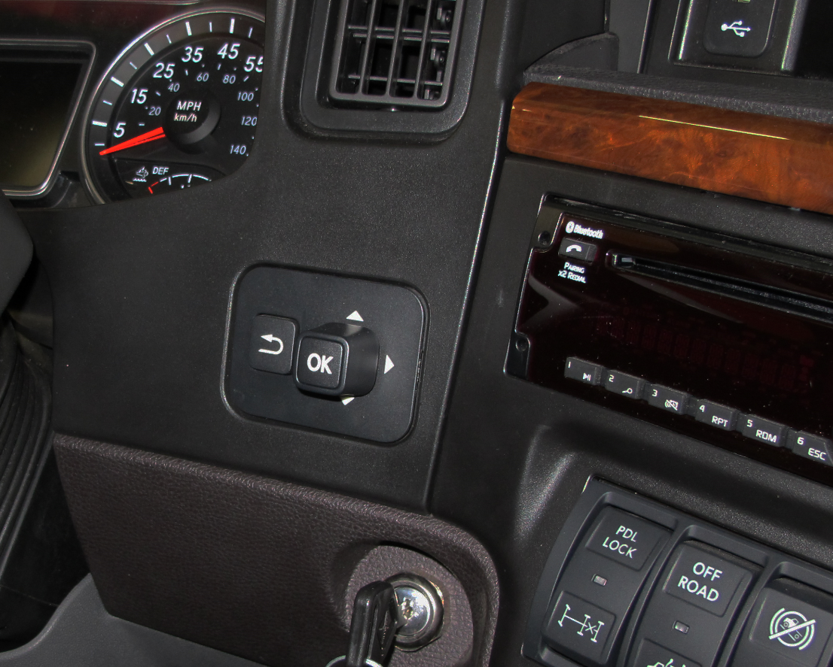
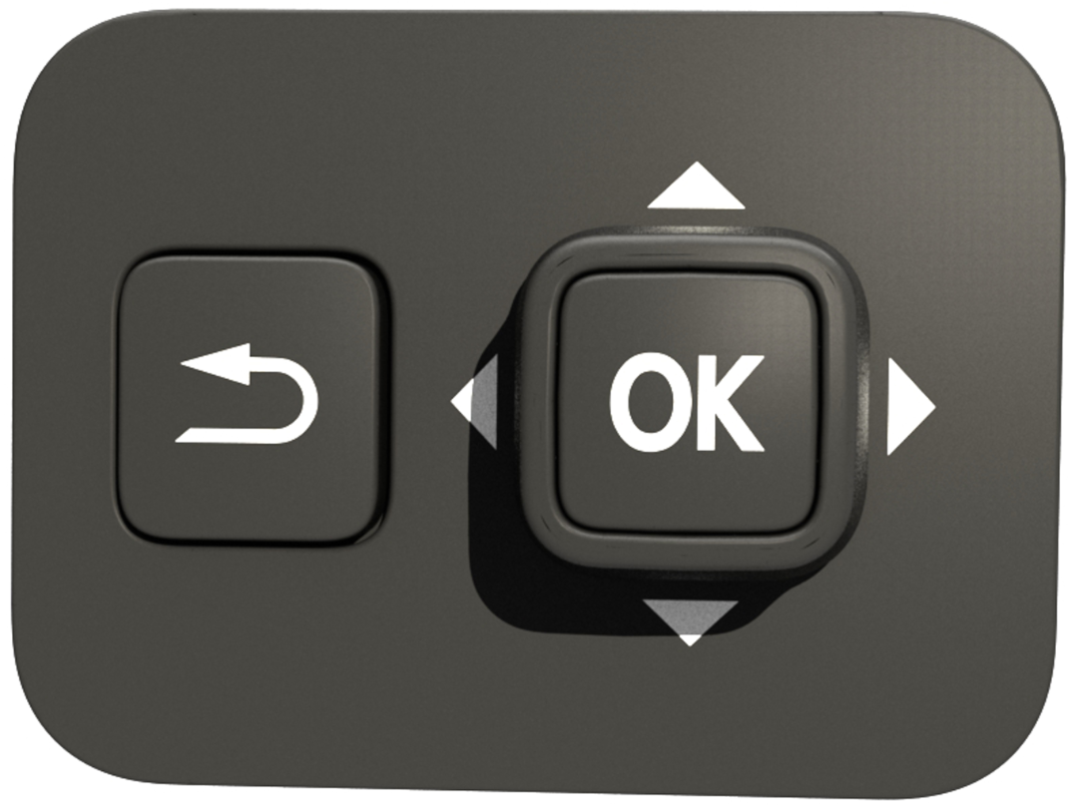
Premium Cluster Navigation
Pagination control module
  Use for premium cluster only
  Located on the instrument panel
  Activated by top or bottom switches
    Back button returns to previous page / subcategory, then to main home screen page
OK / reset button lets you select a highlighted category or hold for 3 seconds to reset the highlighted item
    Navigation buttons let you navigate from one category to another in up and down (within a category) or left and right directions (for main menu and to move from one main category to another)
Notes:
Here is our Pagination control module that is only included with the premium cluster. It is located on the instrument panel to the right of the column and above the ignition switch. This is where you will control the information being displayed on the premium cluster. It is similar to a joystick and you can navigate left, right, up or down. Pushing the center OK button allows you to select a category or reset it. He back button makes it easy to get back to a previous page or back to the home page.

Slide 23
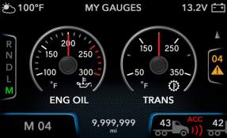
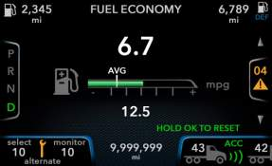
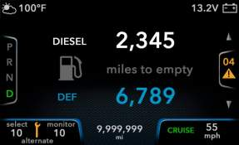
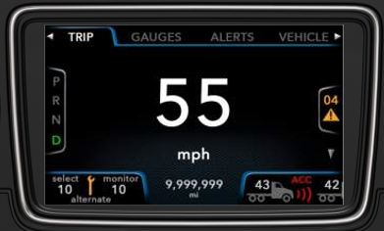
Premium Cluster
Configurable display with 4 easily accessible favorite screens
  Select from up to 15 virtual gauges if vehicle equipped with sensors
  Instantaneous & Average fuel economy
  Diesel and DEF miles to empty
Notes:
Here are 4 easily accessible favorite screens. The virtual gages shows any 2 of the 15 available gauges. It is important to note the truck must be equipped with the sensor for the virtual gauge or it cannot be displayed here. Another of the favorite screens shown here is the fuel economy and it displays both the instant and average fuel economy at a glance. The bottom center image is showing the speedometer digitally and the top right you see how far until empty for both the diesel fuel and the DEF.

Slide 24
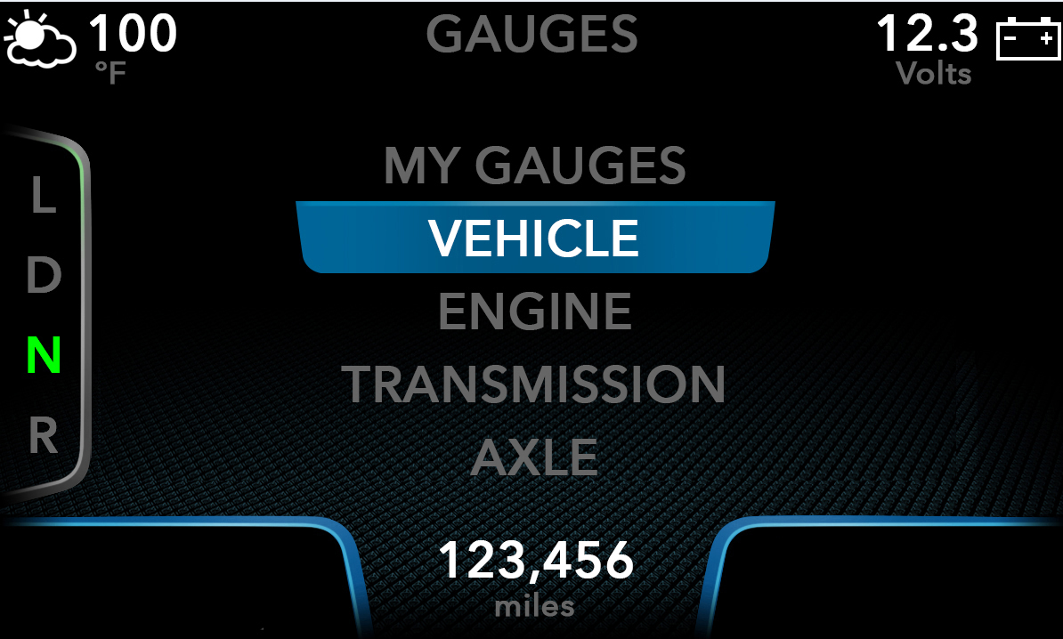
Premium Cluster
Premium cluster sub menu
  Activated by top or bottom switches on pagination control module
Notes:
This is a sample of how it will look when maneuvering through the choices with the pagination switch. As you can see they are making selections in the gauges menu. It should be noted for safety some of the information is not accessible with the LT in motion.

Slide 25
To exit the course, click the X at the upper right of the screen.
Next, click the Return button at the lower left to return to the course grade book.
Please click on and complete the course Post Test to receive credit for completing the course.

